Slide 1


Front-end frameworks

Slide 2
The problem
Changing pages is too slow for many modern web apps
They must use AJAX followed by DOM manipulations to avoid loading HTML pages.
This is possible with plain JS, and it's better with jQuery… But still…
Large apps become too complicated and intractable to maintain.

Slide 3
What frameworks do
Organize the code, making teamwork easier
Can help performance
Can help security
Write less code

Slide 4
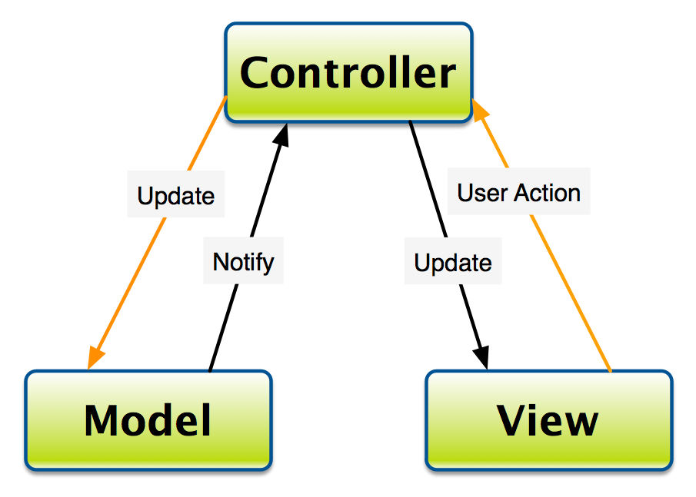
Organization
A lot of frameworks follow a “design pattern”.
A way of “separating concerns”.
Most common is Model View Controller (MVC).
Determines which view
to show, request validity,
permissions, business logic...
Stuff the user
sees.
The data

Slide 5
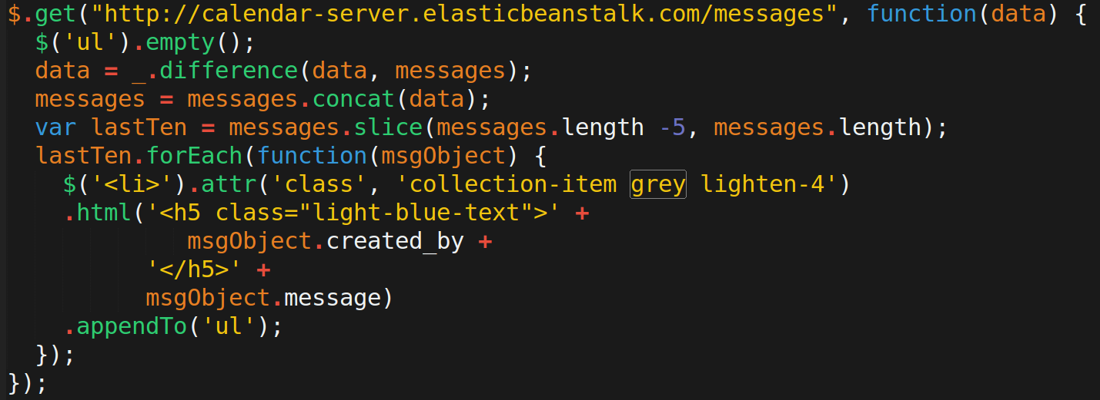
Data, logic, and view mixed up

Slide 6
Performance
Take advantage of some state-of-the-art algorithms
https://facebook.github.io/react/docs/reconciliation.html

Slide 7
_.difference may not be the best

Slide 8
Security
Built-in defense against Cross-site scripting (XSS) and cross-site request forgery (CSRF).

Slide 9
User input becoming HTML code

Slide 10
Most popular right now
AngularJS
ReactJS
EmberJS
BackboneJS

Slide 11
Most popular right now
AngularJS (MVC)
ReactJS
EmberJS (MVC)
BackboneJS (MVC)

Slide 12
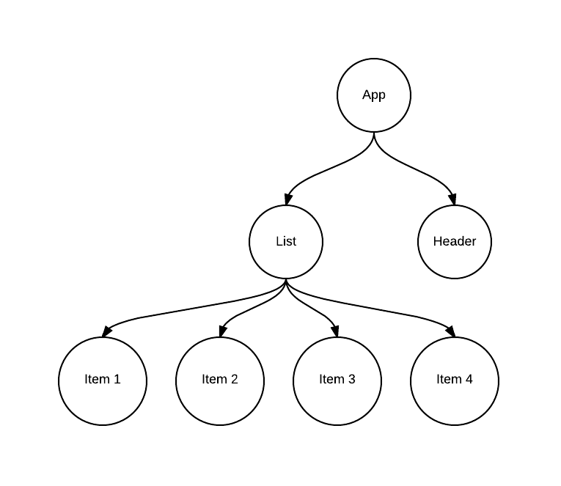
A brief Intro to React
state
{
activeIndex: 1,
scope: day,
weeks: [ … ]
}
< />
the behavior, structure, and perhaps the styles can all be co-located in each “component”
< />
< />
< />
< />
< />
< />
output to the DOM is auto-matically escaped for security
“virtual DOM”

